Slide 1

D&D Group Finder
By: Matthew Berwick & Arodi Kapuadi

Slide 2
Player Use Case

Slide 3
Player Use Case

Slide 4
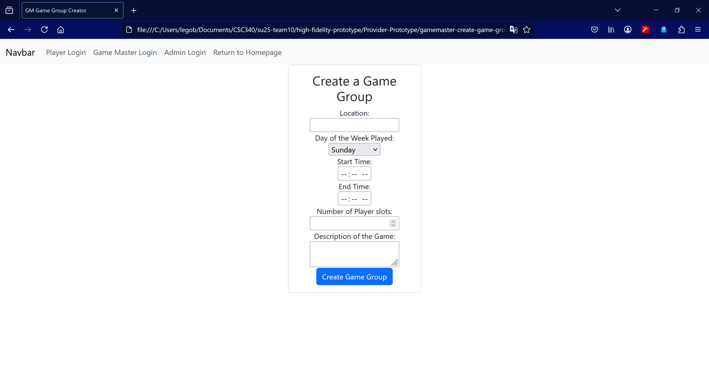
Game Master Creating a Game Group
On this page, a game master user can create a game group, which would be added to a database of all game group.
They will need to enter all the information, which includes the location, the day of the week the game will be played, start/end time, number of player slots, and the description.

Slide 5
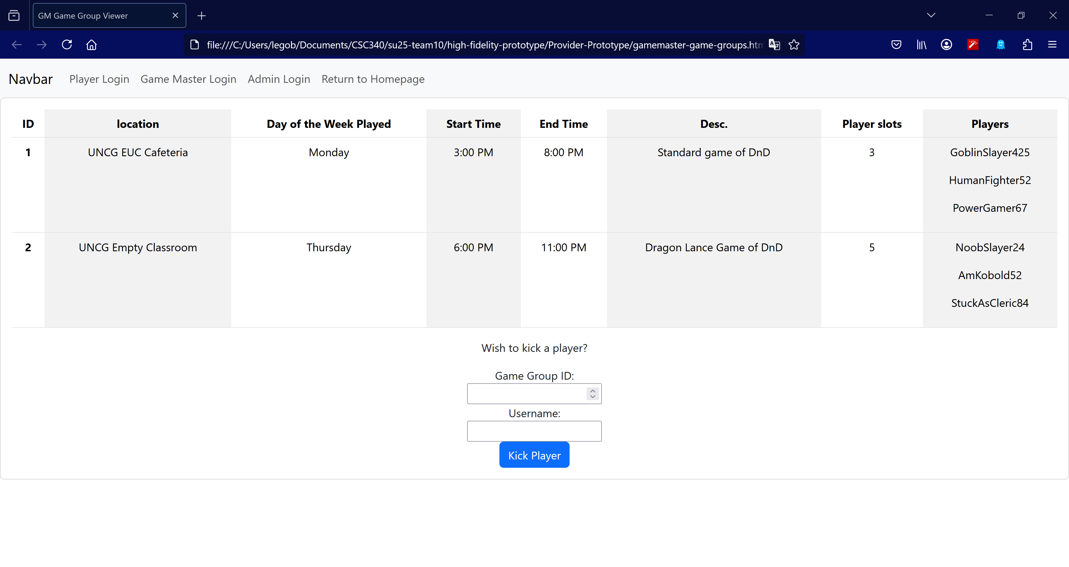
Game Master Viewing Their Game Group
This page allows a Game Master user to view all game groups that they are the game master of.
This would include all the information they entered before, plus any Player users that may have joined.
This page will also allow a Game Master user to kick a player from one of their game groups

